Slide 1
Food Reviews Sentiment Analysis

Slide 2
Team Members
Ahmed Awad
Fares Mohamed
Mohamed Aref
Nuha Jadu
Ahmed Raafat

Slide 3
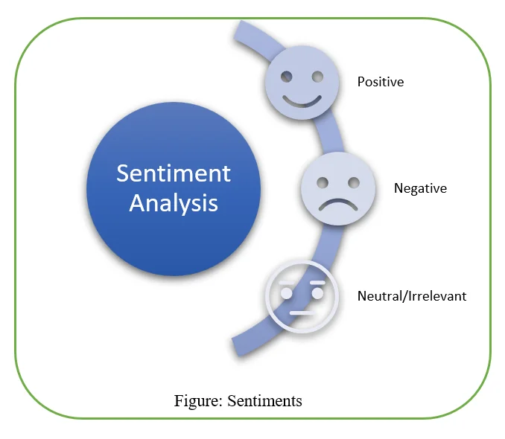
Introduction to Sentiment Analysis
Sentiment analysis: A subfield of natural language processing (NLP) focused on interpreting and categorizing emotions within textual data.
Widely used in applications like customer feedback analysis, social media monitoring, and product reviews.

Slide 4

Importance of Sentiment Analysis
Customer Insights: Helps businesses understand customer preferences and satisfaction by analyzing the emotions behind reviews.
Product Improvement: Identifies common issues or praise points in reviews, enabling targeted product enhancements.
Reputation Management: Allows companies to respond quickly to negative feedback, improving customer relations and brand image.

Slide 5
Dataset: Amazon fine food reviews
The dataset is a collection of Amazon Fine Food reviews, containing diverse customer opinions and offering insights into consumer preferences and satisfaction, making it ideal for sentiment analysis.
It consists of the text attribute, which is the actual text of the food review, and the score, a rating from 1 to 5 indicating the level of satisfaction with the product.

Slide 6
Data Pre-Processing
Pre-processing steps:
Lowercasing
Tokenization
Removing Stop words
Lemmatization
Class balancing via downsampling

Slide 7
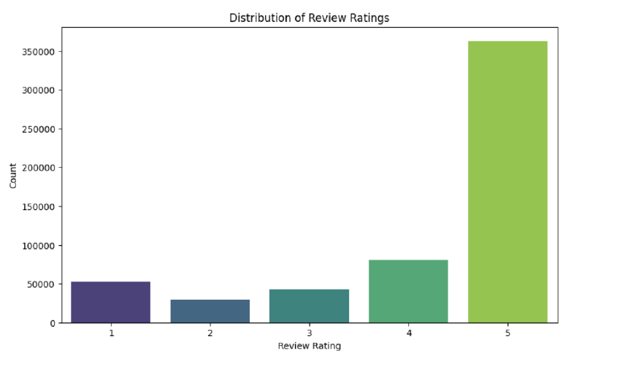
Handling Imbalanced Data
Class imbalance is a common problem in sentiment analysis, particularly with review dataset
Technique used: downsampling the positive class

Slide 8
Mapping Sentiment Scores
In this project, the review scores (1 to 5) are converted into three sentiment categories: 1-2 as negative, 3 as neutral, and 4-5 as positive. This simplification helps streamline the sentiment analysis, making it easier to categorize reviews and analyze trends, as well as improving model performance by focusing on broader sentiment patterns rather than specific numerical ratings.

Slide 9
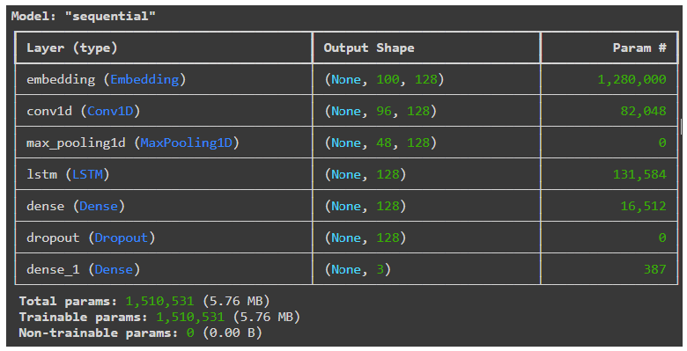
CNN-LSTM Model Architecture for Sentiment Classification
Embedding layer
Convolutional layer (CONV1D)
Maxpooling layer
LSTM layer
Dense layer
Softmax activation function

Slide 10
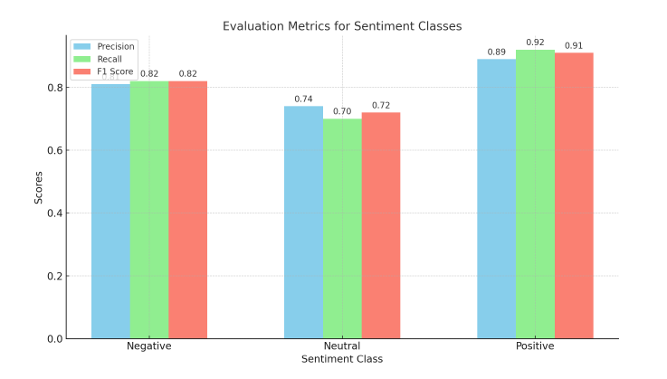
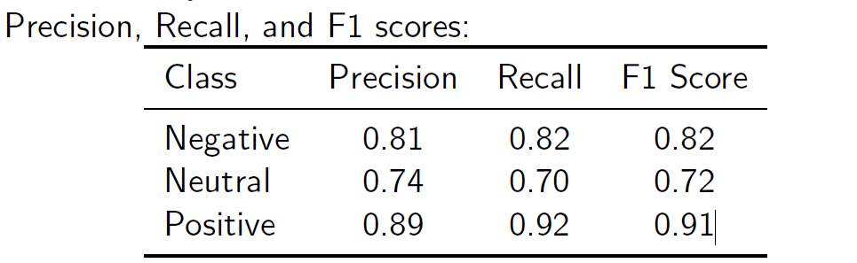
Model Performance
Test accuracy: 84%±2

Slide 11
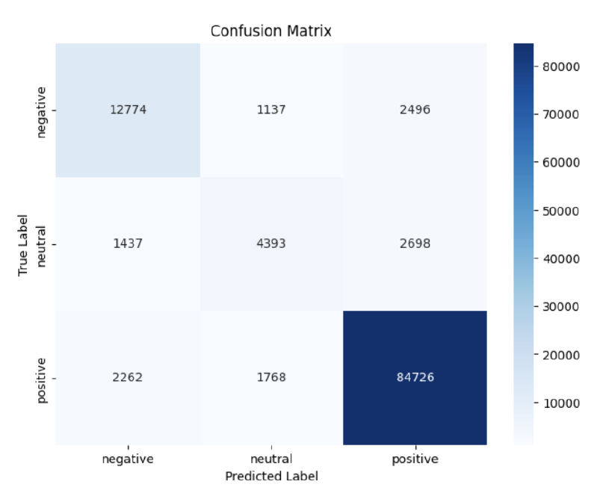
Model Performance
Confusion Matrix

Slide 12
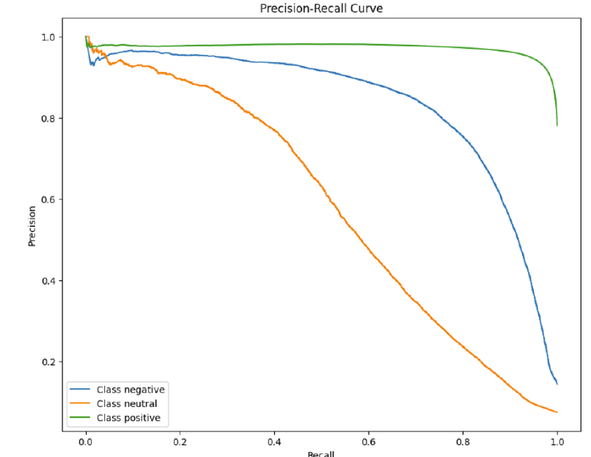
Model Performance
Precision-Recall Curve

Slide 13
Conclusion and Future Work
CNN-LSTM model demonstrated strong performance in sentiment analysis
Possible improvements:
Experiment with transformers and attention-based models
Incorporate additional features like review length and product metadata

Slide 14
Thank you

